Slide 1
Management of Enterprise Networks
Network Management
Prof. Dr. Panagiotis Papadimitriou

Slide 2
Enterprise Network Design Limitations

Slide 3
Challenges in Large Enterprise Networks
Massive scale:
    Large enterprise networks can comprise many thousands of hosts
High efficiency and availability is required
Minimal configuration overhead:
    Host/service discovery
    Host mobility
    Network topology changes
    Implementation of network-wide policies

Slide 4
Existing Enterprise Network Architectures
Ethernet architecture:
    Simplified configuration
    Scalability limitations
Hybrid IP/Ethernet architecture:
    Better scalability than Ethernet
    Significant configuration overhead
    Difficult to implement network policies

Slide 5


Ethernet-Based Enterprise Network
Single layer-2 subnet
DHCP Server
DNS Server
Internet
Switch
Gateway
Switch
Switch

Slide 6
Benefits of Ethernet Architecture
Simplicity:
    Plug-and-play
      Each host is assigned a persistent MAC address
      Ethernet switches automatically learn host addresses and locations
    Network topology changes and host mobility are handled easily due to flat addressing
      Administrators do not have to reassign addresses to hosts

Slide 7
Limitations of Ethernet Architecture (1)
Network-wide flooding:
    Large number of control messages while disseminating host information
    Control message processing consumes resources at end-hosts and switches
Large forwarding tables:
    Switches have to maintain large forwarding tables
      Forwarding table size is proportional to the number of hosts due to flat addressing
Spanning-tree inefficiencies:
    Waste of bandwidth at links that do not participate in the spanning tree
    Longer paths
    Increased load in the links adjacent to the root bridge

Slide 8
Limitations of Ethernet Architecture (2)
Broadcast traffic:
    Resource consumption:
      ARP and DHCP rely on broadcasts for physical address resolution and network address assignment
      ARP broadcasts are frequent and consume bandwidth and processing resources, since broadcast frames are received and processed by every host
    Security issues:
      Malicious hosts can easily launch ARP or DHCP floods

Slide 9
Hybrid IP/Ethernet Enterprise Network
Multiple Ethernet-based IP subnets interconnected by routers
194.12.1.0/26
194.12.1.64/26
Gateway
Internet
Router
Router
Router
Router
194.12.1.128/26
194.12.1.192/26

Slide 10
Benefits of Hybrid IP/Ethernet Architecture
Better scalability:
    Smaller control overhead
      Control messages flood the corresponding subnet and not the entire network
    Smaller forwarding tables
      Forwarding table size is proportional to the number of subnets (and not to hosts) due to hierarchical addressing
Improved efficiency:
    Shortest-path routing (as opposed to traversing spanning trees) improves resource efficiency

Slide 11
Limitations of Hybrid IP/Ethernet Architecture
Configuration overhead:
    Administrators should assign manually prefixes to subnets
      Main goal is the right balance between future use of IP addresses and wasted address space
    Host IP address assignment via DCHP should be consistent with prefix assignment
    Network topology changes require manual reconfiguration
Limited mobility support:
    Host mobility is restricted within a subnet where the host can maintain its IP address
    Mobility across subnets requires reconfiguration (e.g., IP address reassignment) and may cause service disruption

Slide 12
Scalable Ethernet Architecture for Large Enterprises (SEATTLE)
Some slides from J. Rexford’s “Enterprise Configuration” Lecture

Slide 13
SEATTLE Objectives
Avoid network-wide flooding:
  Unicast-based hosts’ location discovery and dissemination
Avoid broadcast traffic for bootstrapping (DHCP and ARP):
  Unicast-based bootstrapping
Reduce the forwarding table size:
  Distribute host location information among the switches
  Install host location information only when needed (reactive resolution)
Avoid spanning-tree inefficiencies:
  Shortest-path forwarding
Avoid end-host modifications:
  End-hosts should use the existing protocol stack

Slide 14
SEATTLE Overview
Flat addressing:
  Switches use hosts’ MAC addresses for routing
  No configuration overhead and backwards-compatibility
Automated host discovery at the edge:
  Switches detect the arrival/departure of hosts
  Avoids flooding and achieves scalability
Hash-based on-demand resolution:
  Hash deterministically maps a host to a switch
  Switches resolve end-hosts’ location and address via hashing
Shortest-path forwarding between switches:
  Switches run link-state routing to maintain only switch-level topology (i.e., they do not disseminate end-host information)

Slide 15
SEATTLE: Network-layer One-hop DHT
Switches maintain <key, value> (e.g., <MAC_addr, location>) pairs by commonly using a hash function F:
  F: Consistent hash mapping a key to a switch
  Link-state routing ensures each switch knows about all the other operational switches
  One-hop DHT operation
Benefits of one-hop DHT:
  Reduced lookup complexity
  Fast and efficient reaction to changes
A
C
F(k) = B
B
D
H(k)

Slide 16
SEATTLE Operation
x
Deliver to x
C
Optimized forwarding
directly from D to A
y
Host discovery
or registration
A
Traffic to x
Hash
(F(x) = B)
Tunnel to
egress node, A
Tunnel to
relay switch, B
D
Hash
(F(x) = B)
Entire enterprise
(A large single IP subnet)
LS core
Notifying
<x, A> to D
B
Store
<x, A> at B
Switches
E
End-hosts
Control flow
Data flow

Slide 17
Host Mobility Management
Old Dst
< x, G >
x
< x, A >
Src
when shortest-path
forwarding is used
y
A
D
< x, A >
< x, G >
Relay (for x)
G
B
New Dst
< x, G >
< x, A >
< x, G >

Slide 18
Handling Network Topology Changes
Events that do not affect the switches (e.g., link failure):
  Re-computation of shortest-paths
  No modification is required for key resolution since the switches remain unaffected
Events that affect the switches (e.g., switch failure):
  F provides a new resolver for a key k
  The switch that has published k monitors the status of the resolver
  If F_{new}(k)<>F_{old}(k):
    The switch republishes the <k,value> pair to the new resolver F_{new}(k)
    The <k,value> pair is removed from the old resolver after a timeout

Slide 19
Unicast-based Bootstrapping (1)
Handling ARP requests:
  Hash-based on-demand address resolution
4. Broadcast
ARP req
for a
b
Owner of
(IP_{a} ,mac_{a})
s_{b}
a
5. Hashing
F(IP_{a}) = r_{a}
1. Host
discovery
s_{a}
6. Unicast
ARP req
to r_{a}
2. Hashing
F(IP_{a}) = r_{a}
7. Unicast ARP reply
(IP_{a} , mac_{a} , s_{a})
to ingress
Switch
r_{a}
End-host
3. Storing
(IP_{a} ,mac_{a} , s_{a})
Control msgs
ARP msgs

Slide 20
Unicast-based Bootstrapping (2)
Handling DHCP requests:
  Proxy resolution by ingress switches via unicast
4. Broadcast
DHCP discovery
h
DHCP server
(mac_{d}=0xDHCP)
6. DHCP msg to r
8. Deliver DHCP
msg to d
s_{h}
d
5. Hashing
F(0xDHCP) = r
1. Host
discovery
s_{d}
7. DHCP msg
to s_{d}
2. Hashing
F(mac_{d}) = r
Switch
r
End-host
3. Storing
(mac_{d} , s_{d})
Control msgs
DHCP msgs

Slide 21
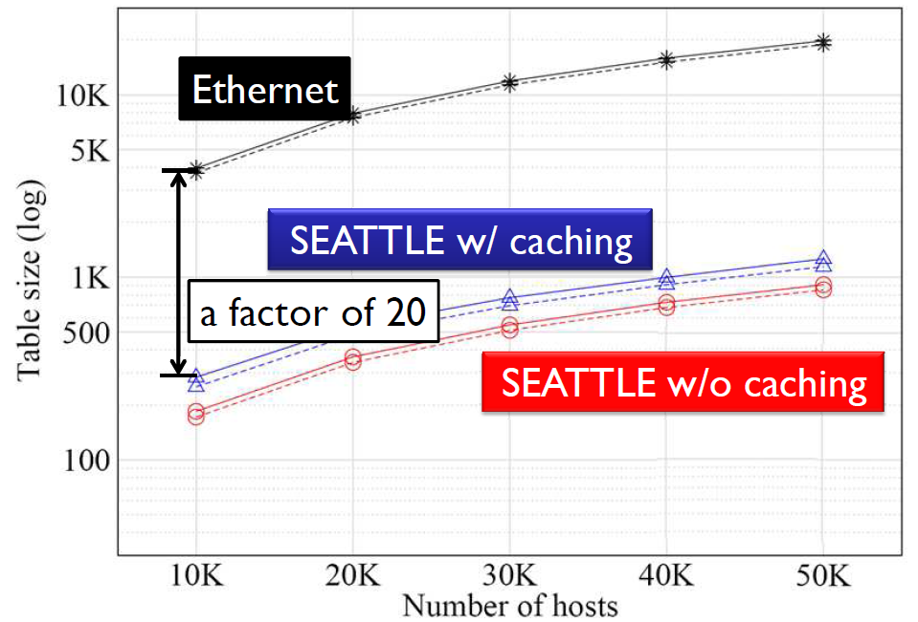
Reduction of Forwarding Table Size with SEATTLE

Slide 22
References
C. Kim, et al., Floodless in SEATTLE: A Scalable Ethernet Architecture for Large Enterprises, ACM SIGCOMM 2008
S. Sharma, et al., Viking: A Multi-Spanning-Tree Ethernet Architecture for Metropolitan Area and Cluster Networks, IEEE INFOCOM 2004
A. Myers, et. al., Rethinking the Service Model: Scaling Ethernet to a Million Nodes, ACM HotNets 2004

